Slide 1

Acceptance and Commitment Therapy (ACT) and Applied Behavior Analysis (ABA)
Victoria Hutchinson, M.S., BCBA
Saint Louis University

Slide 2
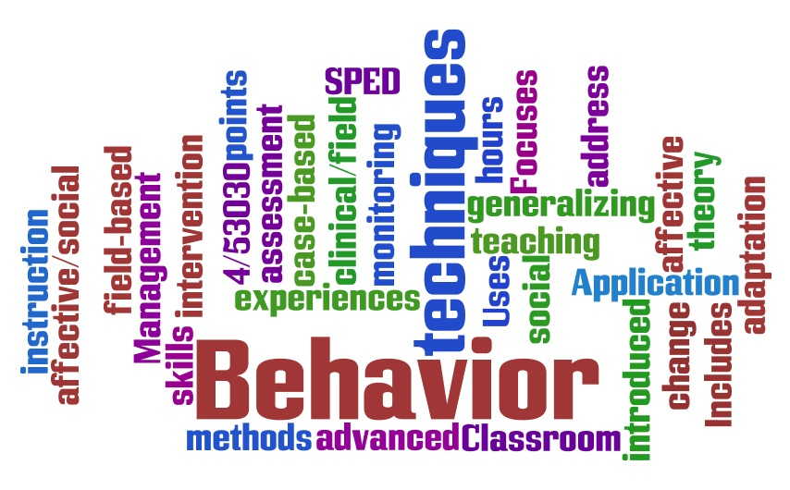
Applied Behavior Analysis
Behavior is anything an organism can DO
Two types:
Contingency-shaped behavior: you DO this, you GET this
Reinforced or punished by consequences
Example: potty training
Rule-Governed Behavior: “You DO this, you GET this”
Verbal stimulus specifying the contingency
Example: If you touch a flame, you will get burned
Notes:
Analyzing function of behavior

Slide 3
The Double-Edged Sword
We can understand rules based on the behavior of deriving relations and transformation of stimulus function
“Mississippi in the summer is like swimming through a bowl of hot soup”
What can you derive about MS?
Don’t have to go to MS now to know this
Pros and Cons:
Problem-solving, following rules for safety, critical thinking
Psychological suffering – experiential avoidance
Notes:
Deriving relation – we can relate anything to anything; how is a puppy better than pizza? How is a puppy the father of pizza?
Avoidance examples: healthy – take a break, watch TV, meditate; unhealthy – alcohol, drugs, over exercise, self mutilation, restricting food
Keep you from living a valued life

Slide 4





Research in Rule-Governed Behavior and Experiential Avoidance
Notes:
Bulk of my research
Lots to figure out in BA because focus is on contingency-shaped bxs
Not enough to treat complex behaviors like depression and anxiety
There is a treatment available, though, just hasn’t been utilized as it should in the field

Slide 5
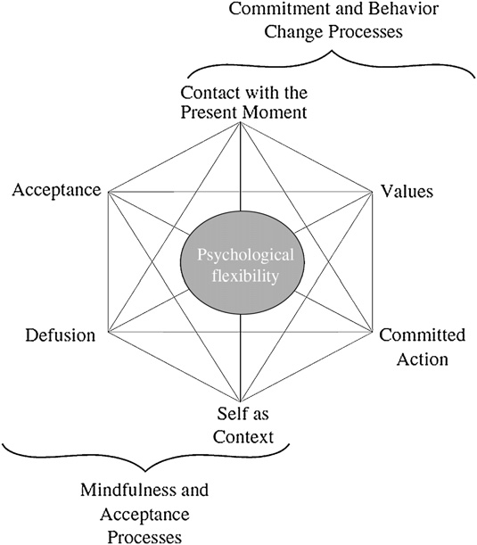
Acceptance and Commitment Therapy
Notes:
6 components; won’t go into detail about each one, but combines mindfulness with behavior change processes
Acceptance, defusion, and SC teach a person to contact psychological events without trying to change or control them or letting them control their behavior
EX: stress in school
Then engage in behavior change processes: present moment, values, and committed actions
Paying attention to the current environment without worrying about past or future things, and behaving in committed actions to get closer to your values: abstract things that are important to you that you never fully have; always working towards it; EX for me is Learning

Slide 6

Acceptance and Commitment Therapy
ACT: acceptance and mindfulness-based intervention formatted in a behavior analytic framework to improve psychological flexibility to decrease experiential avoidance behaviors
Psychological flexibility: contacting the present moment to engage in behaviors consistent with values

Slide 7
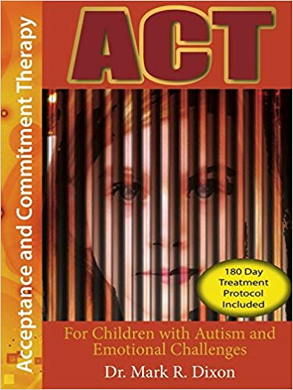
Research in the ABA lab at SLU
RECENTLY, “Exploring the Effects of Individualized Acceptance and Commitment Therapy on Children and Adolescents’ In-class Behaviors and Psychological Flexibility” (In Progress)
Methods:
4 children with varying psychological disorders
30-minute individualized ACT session vs. control conditions
Measured on-task behaviors and challenging behaviors (vocal disruption, aggression, etc.) following sessions
Results: improvements only following individualized ACT sessions

Slide 8

Research to come…
Pilot training for behavior analysts using ACT
Significance:
Autism is commonly treated with ABA services
More likely to have comorbid mental health disorder
Contingency manipulation cannot target complex verbal behaviors

Slide 9
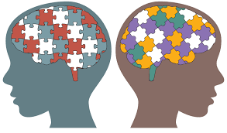
Using ACT for Autism and Comorbid Disorders
More research needed on using ACT for those with developmental disabilities
May need to be modified
Using skills training to target socially significant behaviors
Potential target problems:
Employment
Education
Social Skills
Emotion Regulation

Slide 10

Questions?

Slide 11

Contact information:
Victoria Hutchinson
victoria.hutchinson@slu.edu

